Slide 1



VIRTUAL HEALTH CARE SYSREM
Supervised By:
DR. MST. JANNATUL FERDOUS
Professor
Dept. of Computer Science and Engineering
Jatiya Kabi Kazi Nazrul Islam University
Trishal , Mymensingh-2224
Submitted By:
MD. MONIRUZZAMAN MONIR
Roll:20102024
Reg.No.:8855
RABIA BASHRI TAMANNA
Roll:20102011
Reg.No.:8842
Session: 2019-20
Dept. of Computer Science & Engineering

Slide 2

Outlines
What is Virtual Health Care System?
Objectives
1

Slide 3

WHAT IS VIRTUAL HEALTH CARE SYSTEM ?
A Virtual Health Care System (VHCS) is a digital platform or service that enables the delivery of healthcare services remotely. It leverages technology such as video conferencing, telemedicine, and mobile health application to provide medical consultations, diagnoses, treatments, and monitoring without the need for physical visits to healthcare facilities. This system is designed to improve access to care, especially for patients in remote areas or those with mobility issues.
2

Slide 4

ObJECTIVES
Improve Access to Healthcare Services
Support Healthcare Provider Collaboration
Promote the Benefits of E-Health Services
Enable Remote Health Monitoring with Emergency Support
Ensure Scalability and Reliability
Connect Doctors and Patients Effortlessly
Cut Down Wait Times and Improve Efficiency
Cost Reduction of Consultation
Support Health at Home
Easy to Access and Use
3

Slide 5

BENEFIT OF VIRTUAL HEALTH CARE SYSTEM
Convenience
Accessibility
Access medical advice and services from the comfort of your home, saving time and travel expenses.
Connect primarily with healthcare professionals and specialists regardless of geographic location or physical mobility.
Efficiency
Continuity of Care
Streamline the appointment process, reduce waiting times, and access medical records and test results online.
Ensure seamless communication between healthcare providers, improving coordination and holistic patient care.
Emergency Services
Cost Effectiveness
User can get 24 hours emergency services
Save on transportation expenses and eliminate unnecessary hospital visits.
Awareness
By visiting timeline of the site user can know about new disease, prevention and update news of thieir health.
4

Slide 6



HOW TO ACCESS VIRTUAL HEALTH SERVICES ?
Create an Account
Select Service
Access Services
Once registered, log in to access the E-Health services and start benefitting from the offerings.
Provide your details to register an account on the MT Hospital's E-Health platform.
Choose the type of service you need, whether it's an online appointment, finding a specialist, or admission process.
5

Slide 7

USER LOGIN AND REGISTRATION
Access your personalized account by logging in with your email and password.
If you're new, easily register for an account to enjoy the full benefits of our e-health services.
6

Slide 8
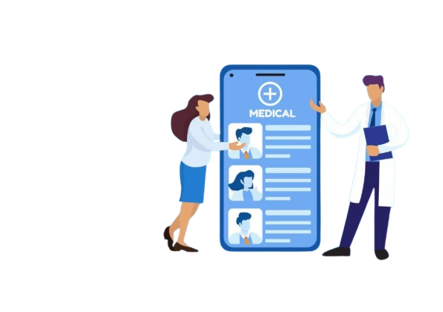
HOW TO FIND A SPECIALIST ?
Find Specialist : Use this online platform to find for specialists by medical expertise, location, and availability.
Specialist Profiles: Detailed profiles provide information about each specialist's qualifications, experience, and areas of expertise.
Direct Conversation: Enable a secure conversation feature that allows patients to ask preliminary questions or share concerns with the specialist assistant before the appointment.
7

Slide 9
ONLINE APPOINMENT PROCESS
User Registration / Login
Find desire Specialist
Go for Appointment
Provide Require information
Submit the form
8

Slide 10

HOW ONLINE MEDICAL CONSULTATION WORKS?
Patients choose an online medical consultation platform or service provider. These platforms may be standalone websites, mobile applications, or integrated into existing healthcare systems. Doctors can join telemedicine consultations using platforms like ZOOM, SKYPE or GOOGLE MEET, offering flexibility and convenience for both patients and healthcare providers.
9

Slide 11
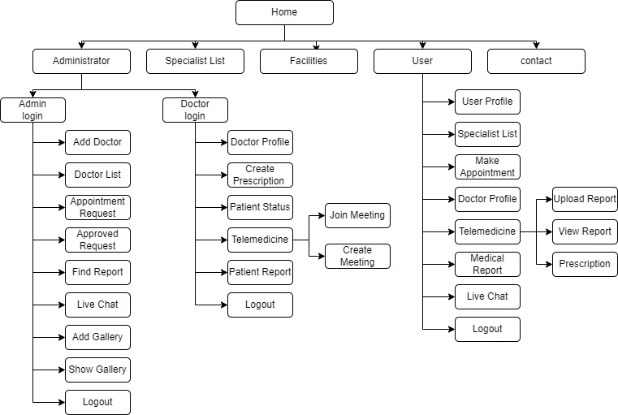
PROJECT FLOW DIAGRAM
10

Slide 12
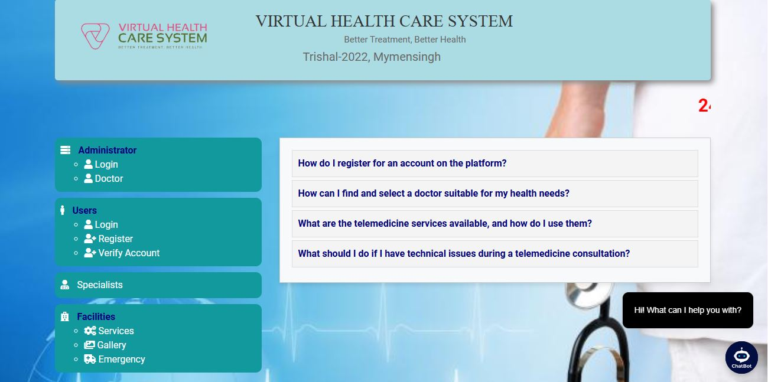
KEY FEATURES OF HOME PAGE
11

Slide 13
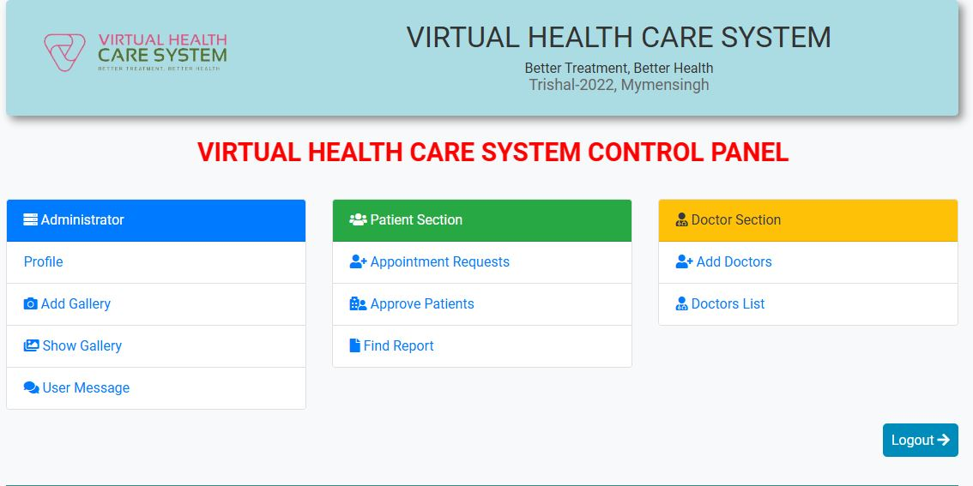
KEY FEATURES OF ADMIN PANEL
12

Slide 14
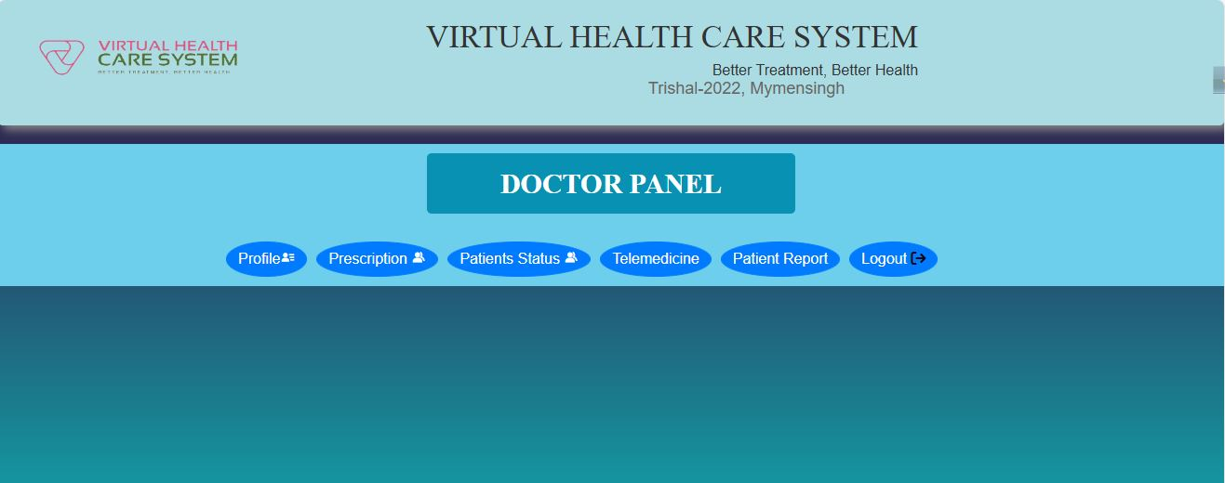
KEY FEATURES OF DOCTOR PANEL
13

Slide 15
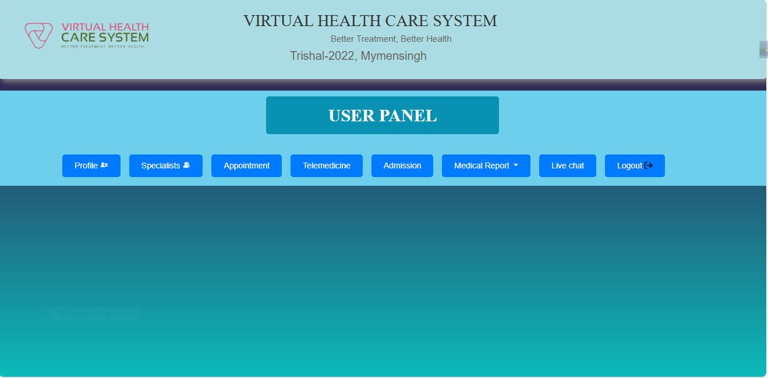
KEY FEATURES OF DOCTOR PANEL
14

Slide 16

DEVELOPMENTS & TECHNOLOGY
Frontend Development Technologies:
HTML (Hyper Text Markup Language)
CSS (Cascading Style Sheets)
JavaScript
Bootstrap
Backend Development Technologies:
PHP (Hypertext Preprocessor)
MySQL
Security Based Authentication:
Session Management
Token-based Authentication
15

Slide 17

LIMITATIONS
Limited Features and Functionality
Poor Mobile optimization
Uses only English Language
16

Slide 18
FUTURE SCOPE
Extend Features and Functionality
Improve Mobile optimization
Uses Multiple Languages
Internet of Medical Things(IoMT).
17

Slide 19
CONCLUSION
Online medical consultation represents a significant advancement in healthcare delivery, offering convenience, accessibility, and efficiency to patients and healthcare professionals.
18

Slide 20

Thank You
19

